Slide 1

Acting Without Boundaries
Strategic Plan
Summary

Slide 2
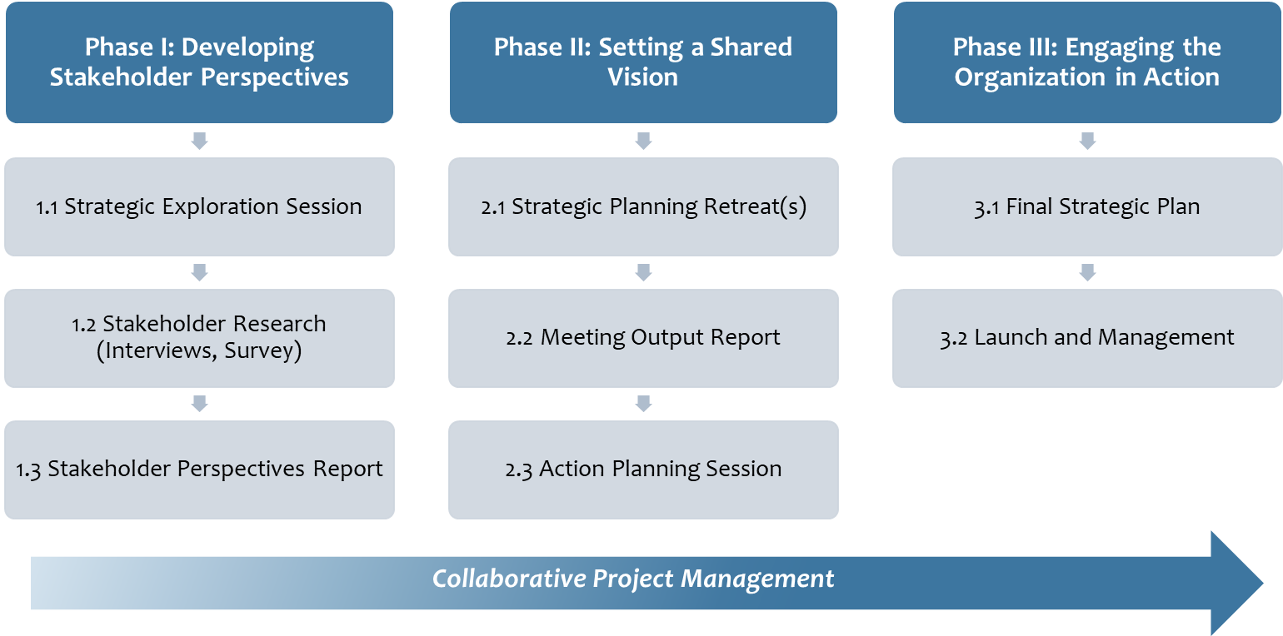
Strategic Planning Process Overview
17 Interviews
82 Survey responses
4 Planned Projects with over 100 detailed, timebound tasks

Slide 3
Overarching Strategies: What are policies and plans for action that will guide AWB in relationship to their evolving ecosystem?
Incremental Growth and Consistency: AWB will develop an expanded, consistent set of complementary programs and performances. Through the performing arts, Acting Without Boundaries creates life-changing experiences to challenge and inspire its actors, audiences, and partners to stretch beyond the perceived limits of individuals with physical disabilities.
Impact Through Numbers: Acting Without Boundaries seeks to engage and develop a relationship with as many individuals with physical disabilities as possible and create a path to support and enable its actors to achieve personal growth and the highest level of their performing arts ability.
Shared Value Partnership: To expand beyond what it can offer alone, Acting Without Boundaries will selectively seek to establish and grow its partner relationships in order to create exponential growth.

Slide 4
Organizational Vision (5-Years)
Focus Area | By 2028…
Programming | AWB has a regular cadence of large performances, an expanded curriculum, including a catalog of challenging performing arts opportunities, a formalized social engagement strategy, and specialized offerings for the neurodiverse.
Infrastructure & Support | AWB’s board, staff, and internal policies can support and sustain the organization’s expansion into the future.
Outreach | AWB has grown its ability to attract a more diverse audience and recruit new actors and volunteers through an increased online presence, coverage in local media, and a documentary narrative that is in sync with the organization’s brand.
Partnerships | AWB has created partner arrangements that further the organization’s programs, logistics, infrastructure, presence, and overall value/impact.

Slide 5
Strategic Projects
Focus Area | Over the next two years…
Programming | AWB will incrementally expand its existing programs and performances, formalize its social programming, and test other areas for growth.
Infrastructure & Support | AWB will have its policies and procedures established, by building its internal team strength, and develop its board to achieve its growth objectives and support its strategy.
Outreach | AWB will have the tools and support in place to share its story to broader audiences by utilizing its own online presence, new video content, and its Melodies program.
Partnerships | AWB will clarify its priorities for partnerships, its objectives, and its own value in order to prepare to actively develop specific partner relationships.

